Slide 1
Lecture 2 Describing and Visualizing Distributions

Slide 2
Sampling and Data
Statistics is generally concerned with studying properties of a population – the collection of all possible persons, events, or objects of interest
e.g the set of all possible observations – observed + unobserved
Populations can be real and finite/countable (e.g. All employees at a company) or hypothetical and potentially infinite/uncountable (e.g all possible hands in a game of poker)
A Sample is a subset of the population that we actually observe – the observed observations
The idea of Sampling is to select a portion or individuals or objects that are representative of the population
By studying the sample we can gain insights about the population
Population
Sample

Slide 3
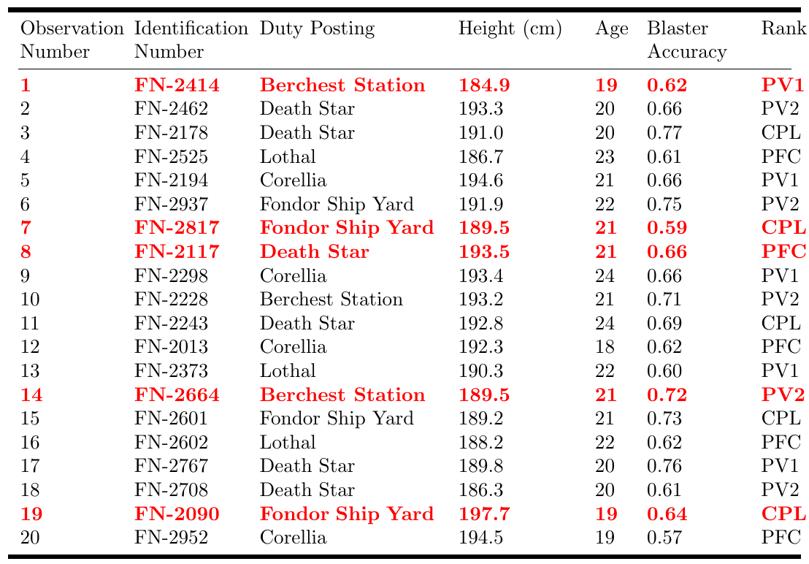
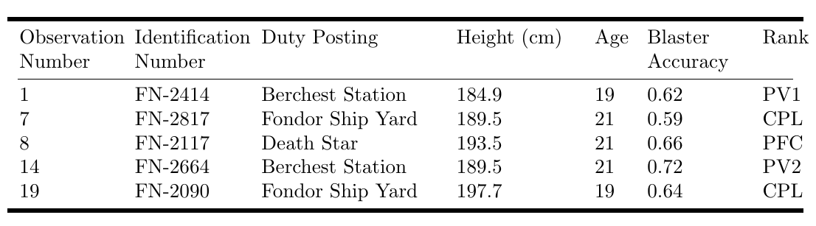
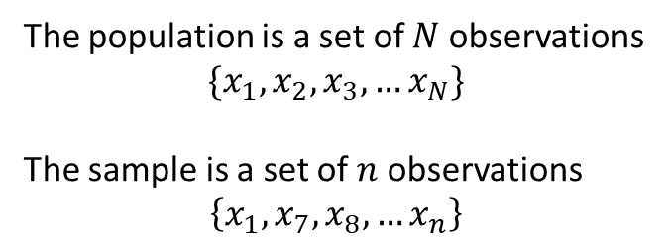
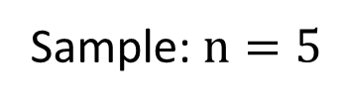
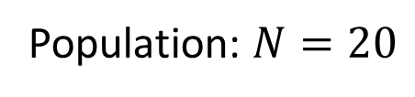
Example
The population is a set of $N$ observations
$$\{x_{1}, x_{2},x_{3},…x_{N}\}$$
The sample is a set of $n$ observations
$$\left\{x_{1},x_{7},x_{8},…x_{n}\right\}$$
Population: $N=20$
Sample: $n=5$

Slide 4
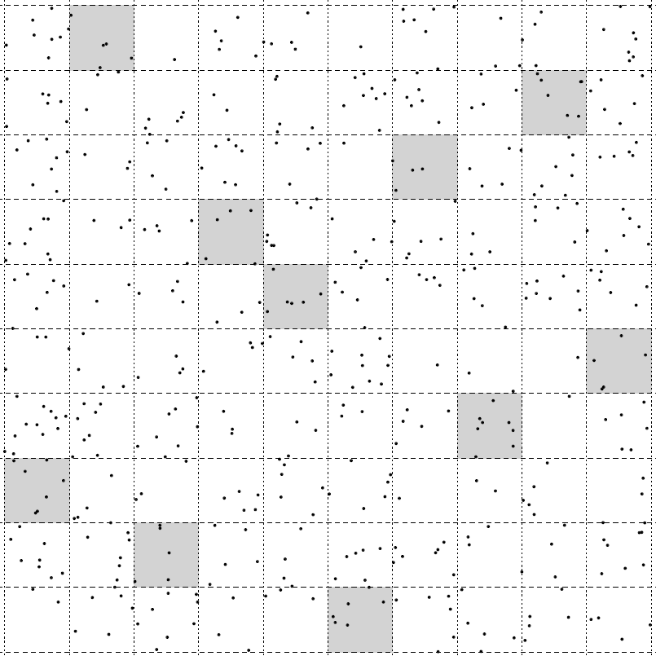
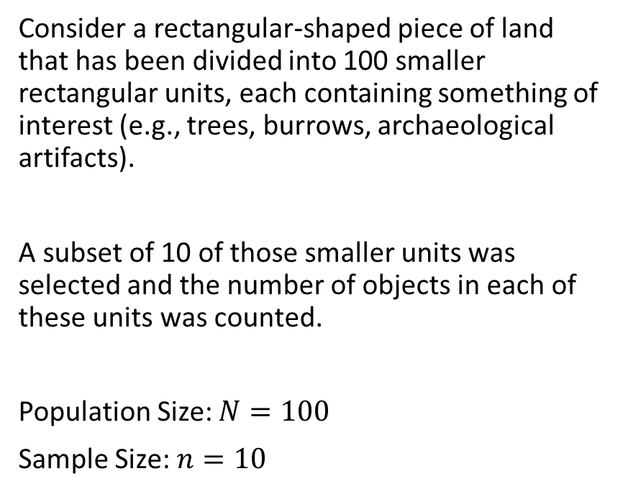
Example 2
Consider a rectangular-shaped piece of land that has been divided into 100 smaller rectangular units, each containing something of interest (e.g., trees, burrows, archaeological artifacts).
A subset of 10 of those smaller units was selected and the number of objects in each of these units was counted.
Population Size: $N=100$
Sample Size: $n=10$

Slide 5
Why is statistics so valuable?
Most of the time, we can’t measure everyone or every unit in the population and therefore must limit our measurements to a sample.
Statistics primarily deals with estimation – the process of inferring an unknown quantity about a population using set of sample data
The tools for estimation allow us to approximate almost everything about populations using only samples.

Slide 6
Where we can go with estimates
With estimates we can
Assess differences among groups and relationships between variables.
Describe populations. Examples of estimates include averages, proportions, measures of variation, and measures of relationship.
Then we can ask and answer questions or formally, test and evaluate hypotheses.

Slide 7




Statistics Vs Parameters
A statistic is a numerical characteristic of a sample that estimates a population parameter.
A parameter is a numerical characteristic of a population that can be estimated by a statistic.
Put another way…
A statistic is a function of the observations of in a sample while a parameter is a function of all observations in the population.
Sample
Statistic
estimate
7.8
$$n$$
Population
Parameter
Value
8.2
$$N$$

Slide 8
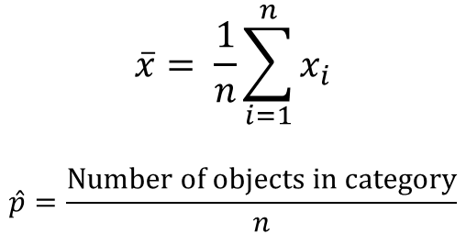
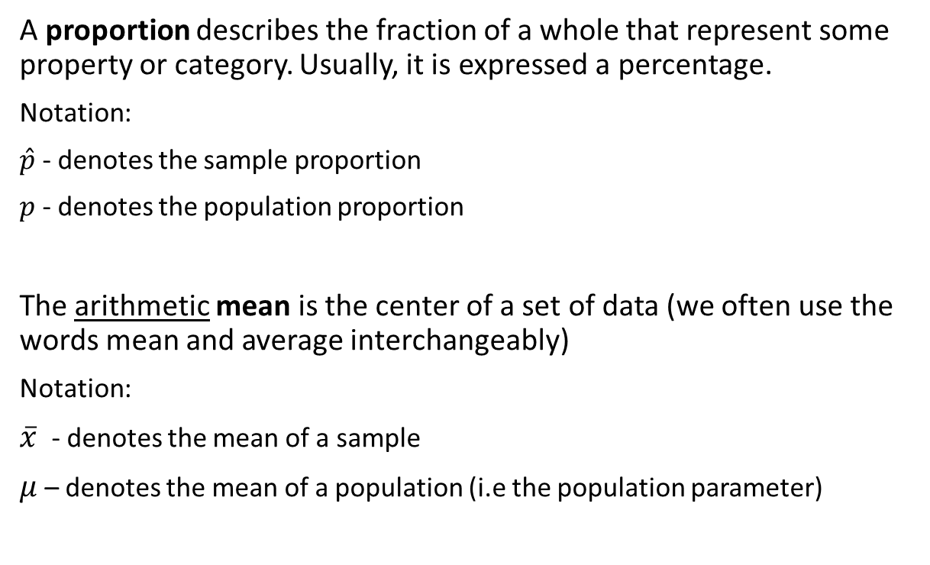
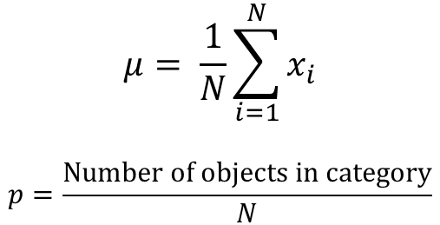
Mean and Proportion
Parameter
$$μ= \frac{1}{N}\sum_{i=1}^{N}{x_{i}}$$
$$p=\frac{Number of objects in category}{N}$$
A proportion describes the fraction of a whole that represent some property or category. Usually, it is expressed a percentage.
Notation:
$\hat{p}$ - denotes the sample proportion
$p$ - denotes the population proportion
The arithmetic mean is the center of a set of data (we often use the words mean and average interchangeably)
Notation:
$\overline{x}$ - denotes the mean of a sample
$μ$ – denotes the mean of a population (i.e the population parameter)
Statistic
$$\overline{x}= \frac{1}{n}\sum_{i=1}^{n}{x_{i}}$$
$$\hat{p}=\frac{Number of objects in category}{n}$$

Slide 9

Example: Gallup Pool
On April 20, 2010, one of the worst environmental disasters took place in the Gulf of Mexico when the Deepwater Horizon offshore oil rig exploded.
In response to the spill, many activists called for an end to offshore drilling for oil.
Almost nine months later, turbulence in the middle east caused the price of oil to surge to an all-time high.
In March 2011, Gallup conducted a survey and found that 60% of Americans favored offshore drilling as means to reduce U.S dependence on foreign oil.
The poll was based on interviews with 1,021 adults aged 18 and older, living in the continental U.S, and selected using random digit dialing.
What is the population under study, and what is the population parameter being estimated? What is the sample statistic ?

Slide 10
Descriptive Vs. Inferential Statistics
Design – The process/method in which we plan to collect data to answer our statistical question
Descriptive Statistics – refers to describing the observations in a sample using statistics or a population using parameters
- collection, organization, summarization and visualization of data
Inferential Statistics (or statistical inference) – refers to using a sample (usually a statistic) to answer a question about a population (such as estimating the value of a parameter)
- estimation, hypothesis testing, determining relationships among variables, prediction

Slide 11
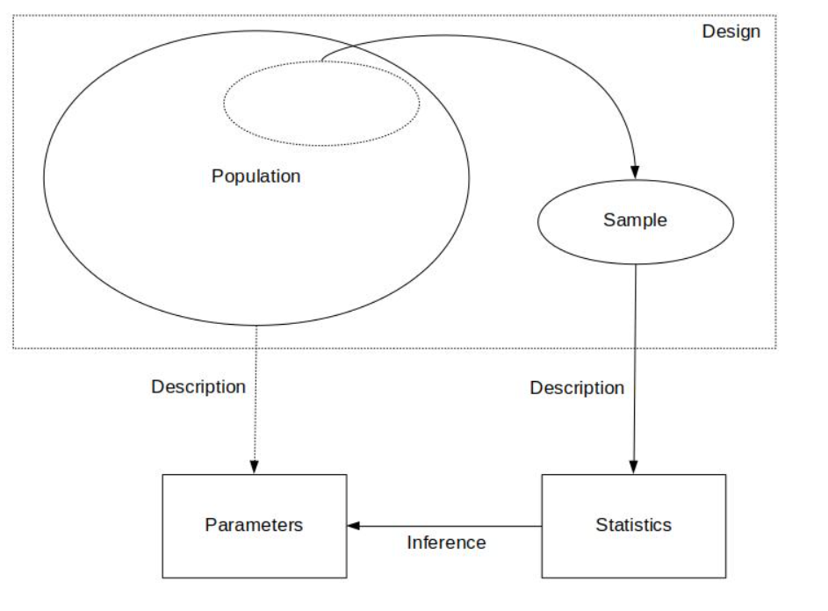
The Big Picture

Slide 12
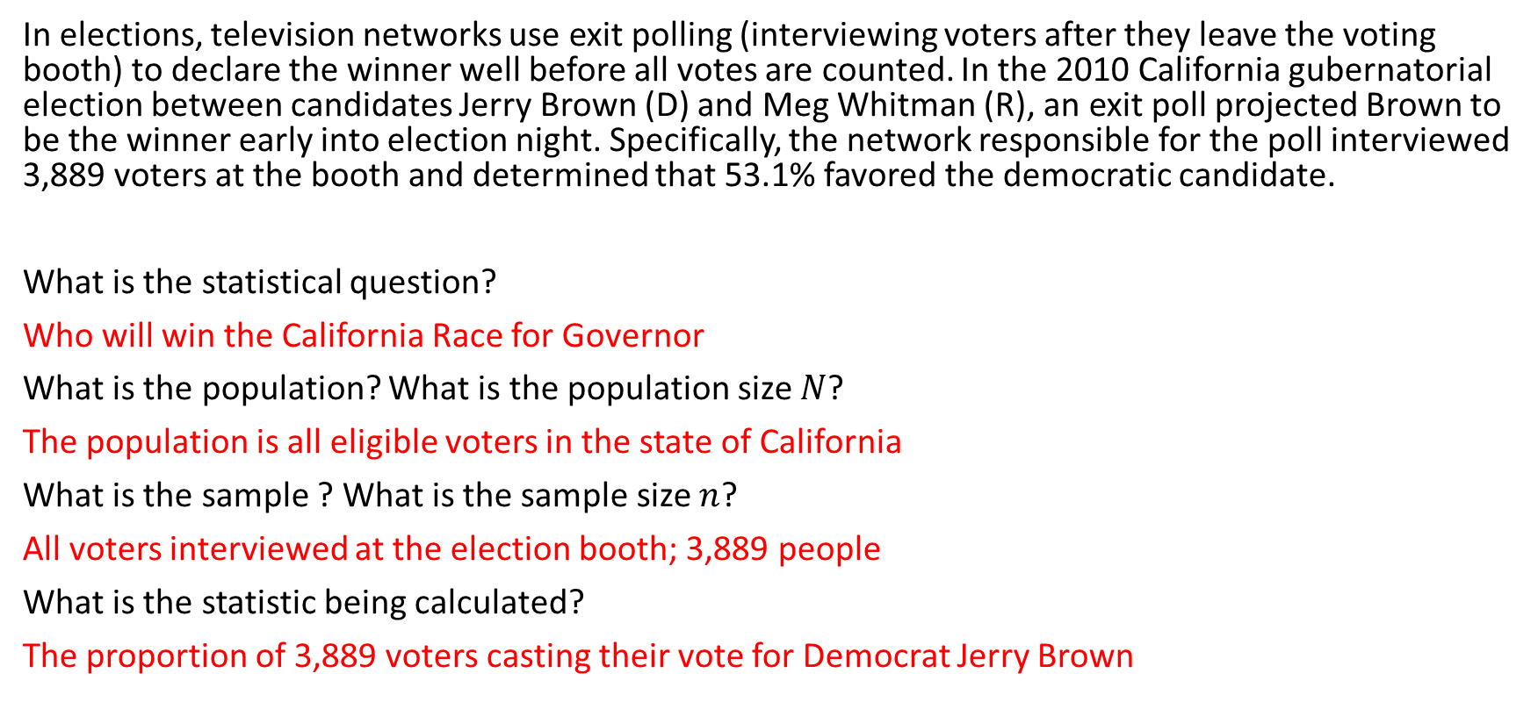
Warm Up
In elections, television networks use exit polling (interviewing voters after they leave the voting booth) to declare the winner well before all votes are counted. In the 2010 California gubernatorial election between candidates Jerry Brown (D) and Meg Whitman (R), an exit poll projected Brown to be the winner early into election night. Specifically, the network responsible for the poll interviewed 3,889 voters at the booth and determined that 53.1% favored the democratic candidate.
What is the statistical question?
Who will win the California Race for Governor
What is the population? What is the population size $N$?
The population is all eligible voters in the state of California
What is the sample ? What is the sample size $n$?
All voters interviewed at the election booth; 3,889 people
What is the statistic being calculated?
The proportion of 3,889 voters casting their vote for Democrat Jerry Brown

Slide 13
Recap:
Design – the goal/statistical question we want to answer and how we plan to obtain our data
Description – a preliminary exploration and summary of the data
Inference – using statistics to make decisions or predictions about the data

Slide 14
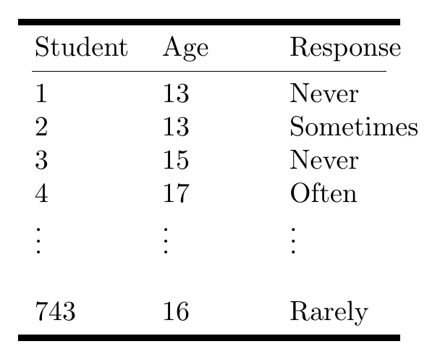
Descriptive statistics
Ex. Are teens distracted by their cell phones? A study conducted by the Pew Research center surveyed 743 U.S teenagers ages 13-17 to understand how cell phones in class impacted their ability to concentrate. Each student was asked to rate the impact of cell phone use on their concentration based on a Likert scale
Methods for summarizing, visualizing and characterizing data
The data can be from samples OR populations
Goal: simplify the data without distorting or losing information
Summaries are easier to understand
Possible Responses: Never, Rarely, Sometimes, Often

Slide 15
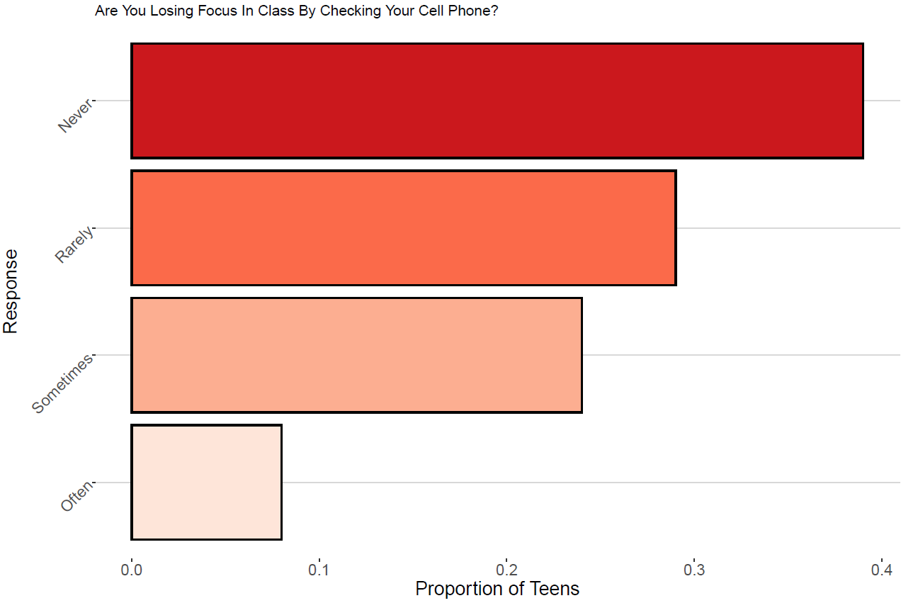

Slide 16

Features of Distributions
A distribution of a variable gives (a) the values that occur and (b) how often each value occurs
Features of A Distribution
Categorical Variables:
Modal category – the category with the highest frequency
Quantitative Variables:
Shape – do observations cluster into certain areas, are values spread out or more densely packed together?
Center – where is the middle point on the distribution, where does a typical value fall?
Variability – how tightly to observations cluster around the center of the distribution

Slide 17
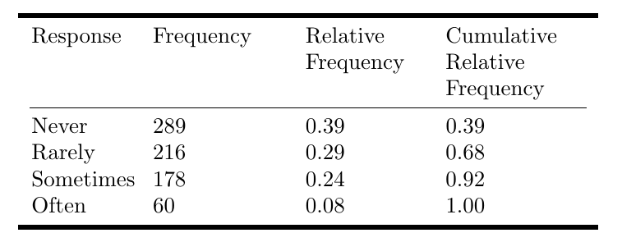
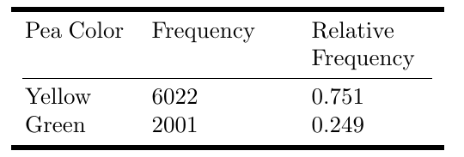
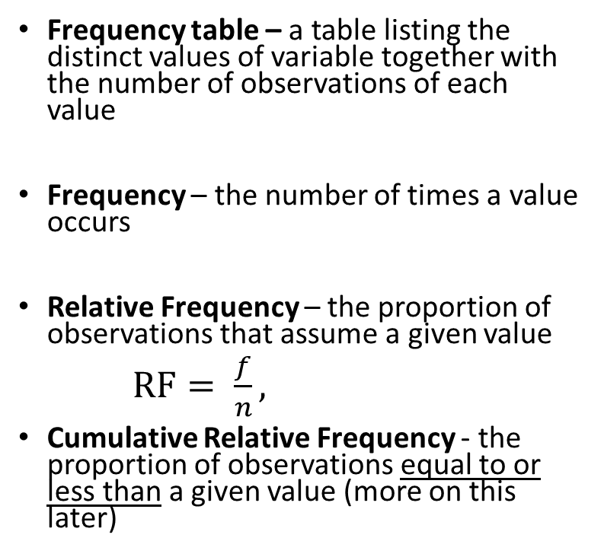
Displaying Distributions: Frequency Tables
Ex. Are teens distracted by their cell phones?
Frequency table – a table listing the distinct values of variable together with the number of observations of each value
Frequency – the number of times a value occurs
Relative Frequency – the proportion of observations that assume a given value
$RF= \frac{f}{n},$
Cumulative Relative Frequency - the proportion of observations equal to or less than a given value (more on this later)
Ex. Mendels Pea Plants - In one of Gregor Mendel’s classic studies,
he bred 8023 pea plants and observed the color of the pea pods.

